Slide 1
Intuition behind transformers
By Sarath

Slide 2
Distributional semantics
a word is characterized by the company it keeps
Lets understand this by playing a simple game.
Find the meaning of the word greebel
Before you go any further, Ask yourself do you know the meaning of greebel?
“Everyday I got to work in a greebel. There are two options for me. The 8:15 slow greebel takes 45 minutes, while the 8:30 fast greebel takes me to work in 30 minutes. If I miss both I can take the purple-line greebel at 8:40, but then, I will need to change twice before reaching office an hour later”

Slide 3
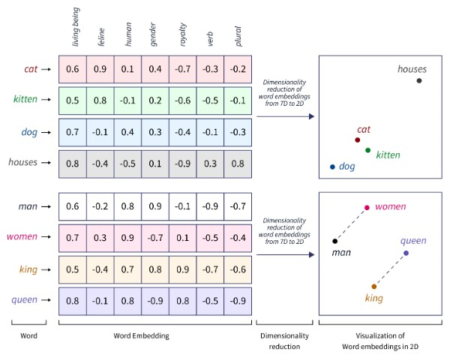
What is an Embedding?
Embedding is a numerical representation of text (words or tokens)
In Transformers every token is represented with a set of 512 numbers (called a vector), BERT base is having 728 of them!

Slide 4
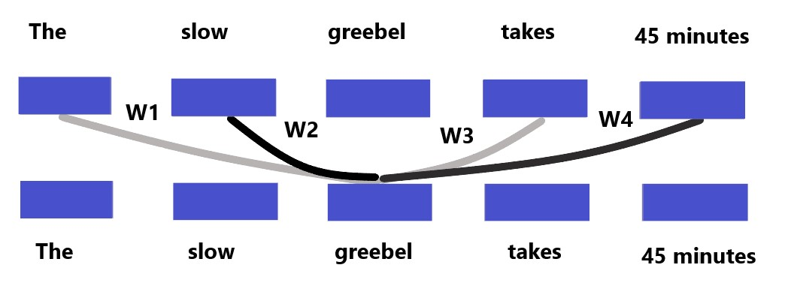
Self Attention - Intuition
Mathematically if we have the numerical representation for each word we can represent the meaning of the unknown word (here greebel) as a weighted sum of other tokens

Slide 5
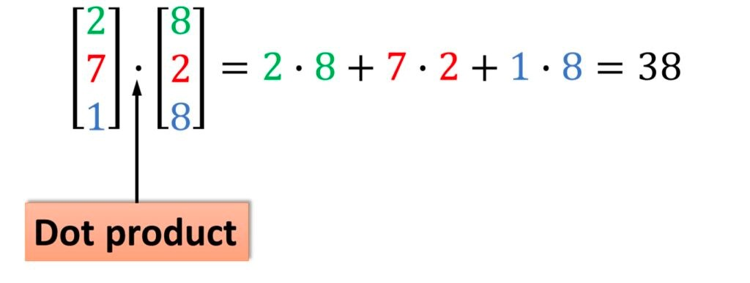
How to compute these weights?
One way is to compute the weights is to find the similarity between words, when we speak about vectors this is called a dot product or cosine similarity
Lets understand dot product with an example
A dot product is defined as an element wise multiplication & summation
https://www.geogebra.org/m/Yu6869By
Lets switch gears and understand Scaled Dot product Attention using the vectors

Slide 6
Agenda
Scaled Dot Product Attention
Multi Head Attention

